Slide 1
Teaser

Slide 2
How to test psychological models…

Slide 3
How to test psychological models…
… without (empirical) data!

Slide 4
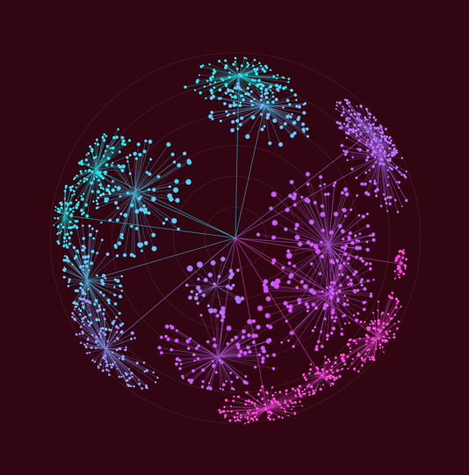
Fancy buzzwords
Holistic
Complex systems
More than the sum of their parts
Network
Emergence

Slide 5
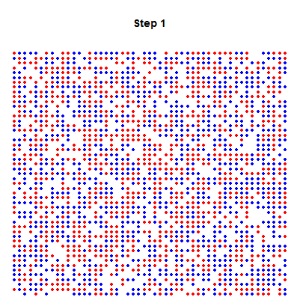

Slide 6
Agent-Based Modeling
Dino Carpentras
Centre for Computational Social Science

Slide 7
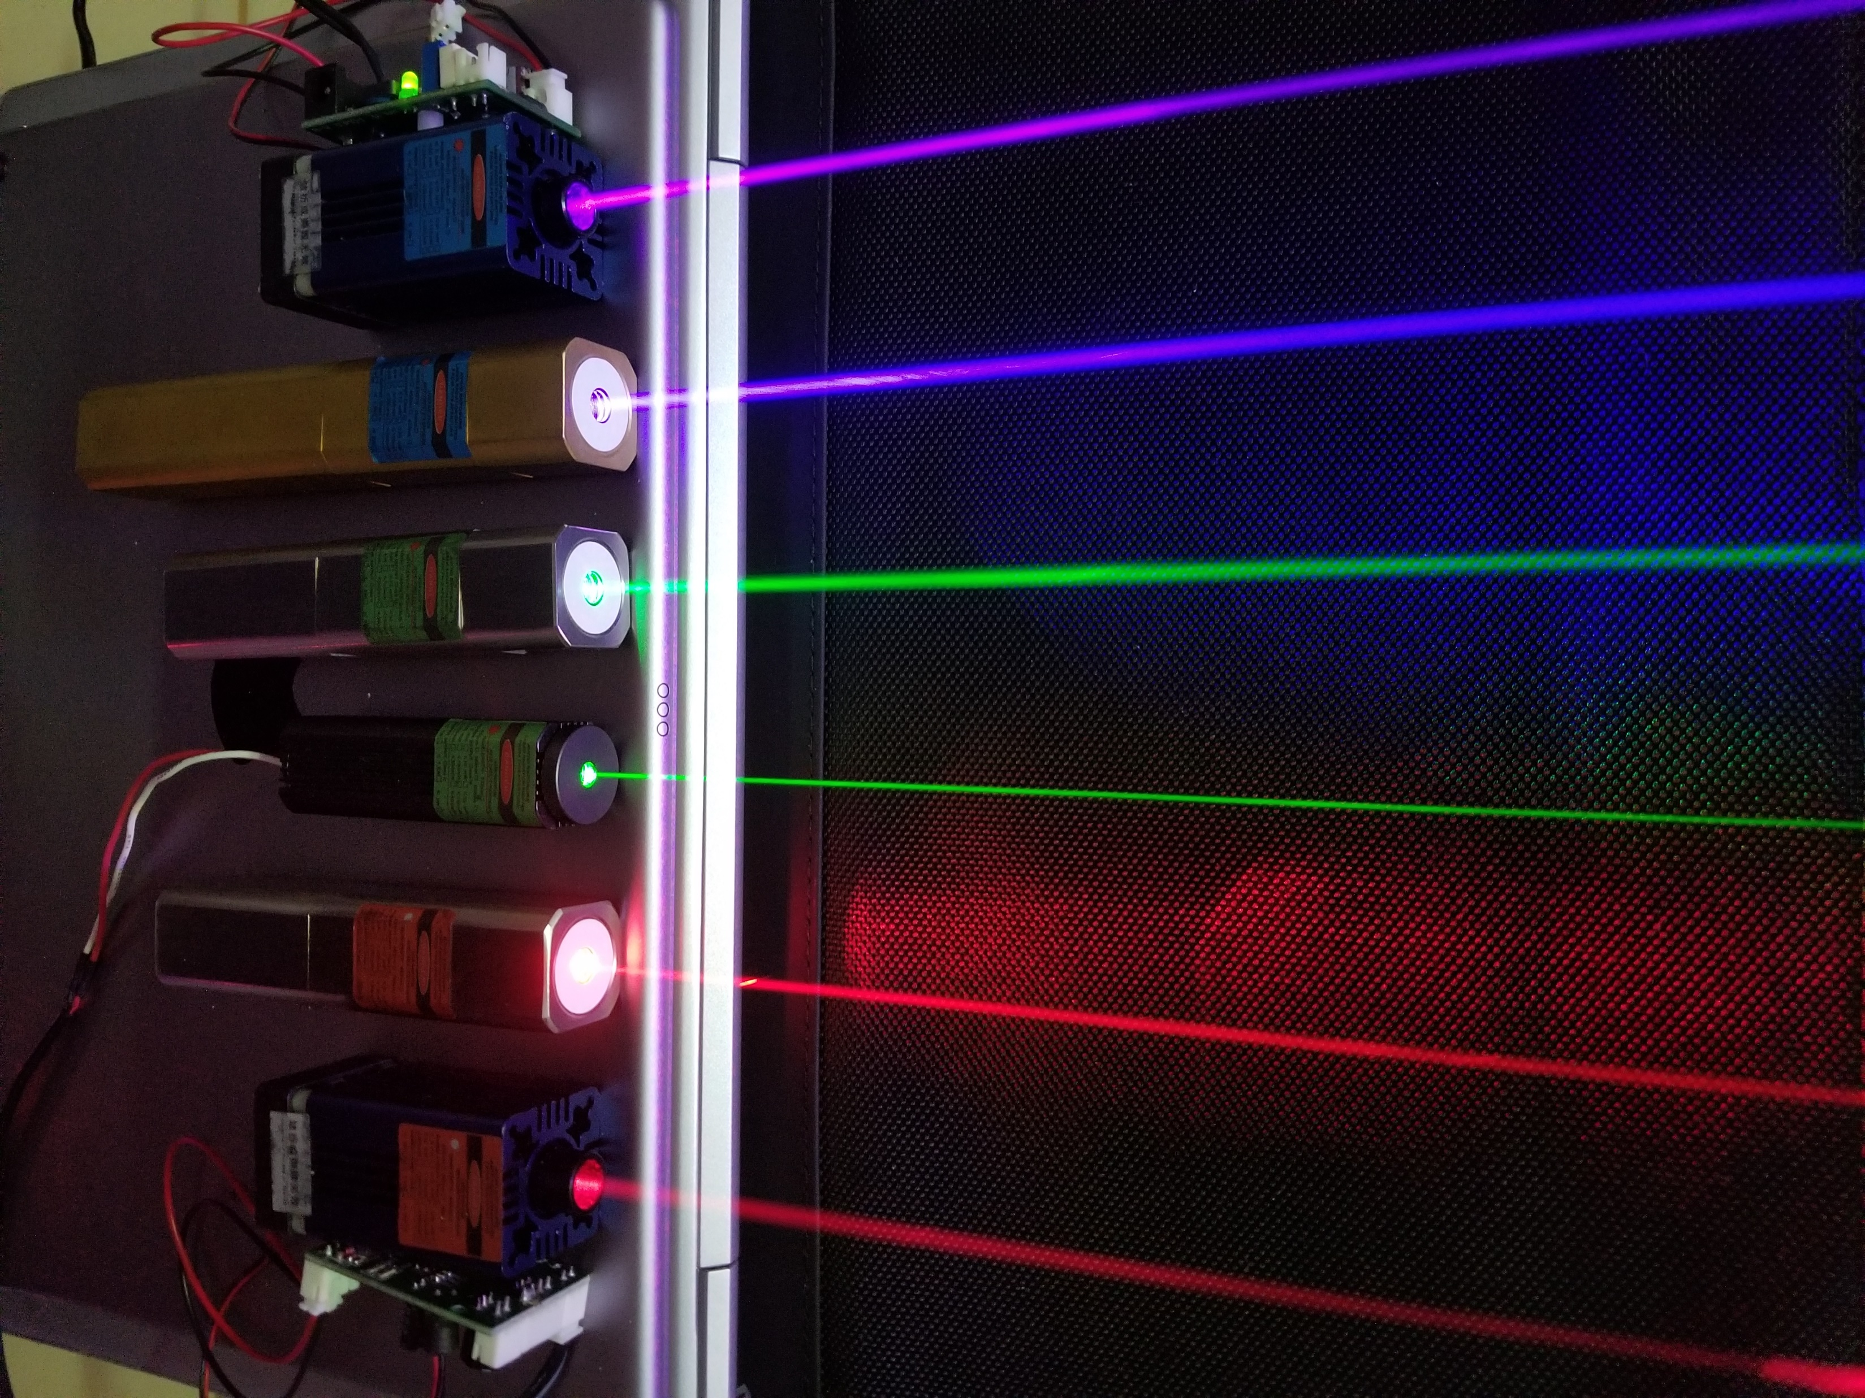
About me
Background
Quantum cryptography
Microfluidics
Photonics
CSS
Dep of psych - Limerick
ETH Zurich

Slide 8
About me
Background
Quantum cryptography
Microfluidics
Photonics
CSS
Dep of psych - Limerick
ETH Zurich
I will use «we» for any communiy

Slide 9
About me
Now
Teaching ABM
Eropean social simulation association
Essa@work
Coordinator of SIG Experimental-ABM
Applications
Opinion dynamics - Vaccination
Belief network
Digital Democracy

Slide 10
Today’s presentation
A
B
C
A
B
C
Flexible

Slide 11
Why complex systems?

Slide 12

Some questions
How do society emerge?
How do people form groups? (e.g. left-right)
Data alone don’t tell a story
We need models

Slide 13
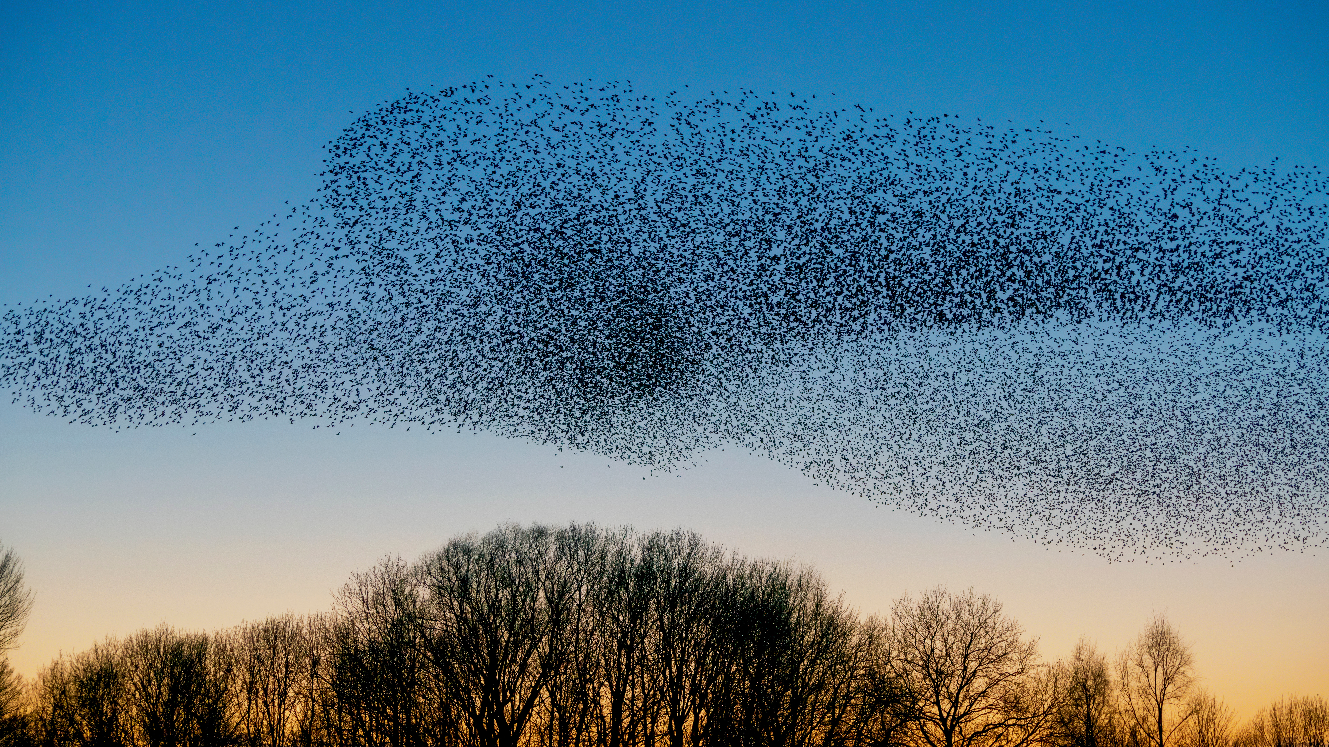
Do we really need a new modeling approach?

Slide 14
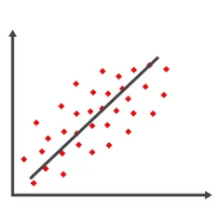
Modeling in the social sciences

Slide 15
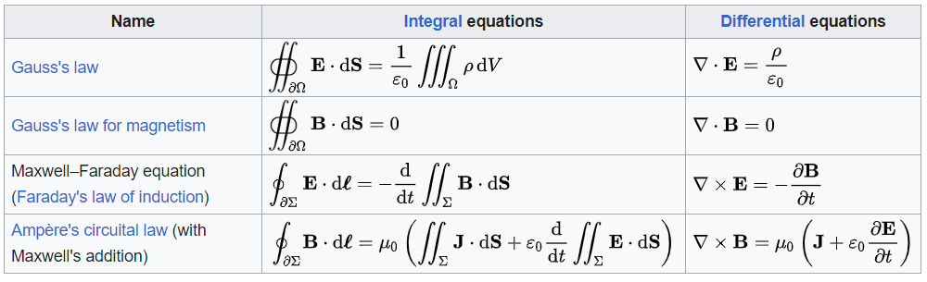
Modeling in physics

Slide 16
Is physics better than psych?

Slide 17
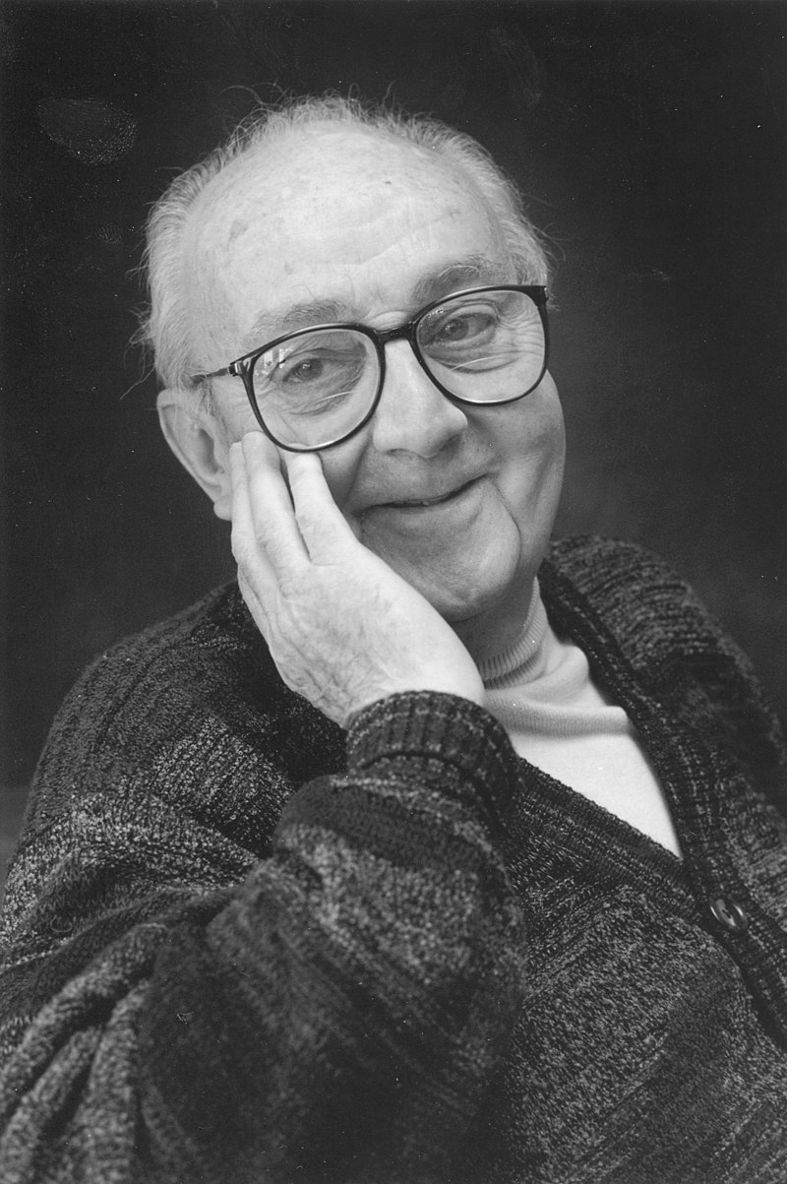
Models are not the real world
All models are wrong, but some are useful
George EP Box
1919 – 2013

Slide 18
The right level of abstraction

Slide 19
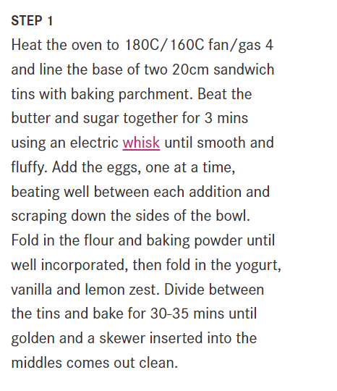
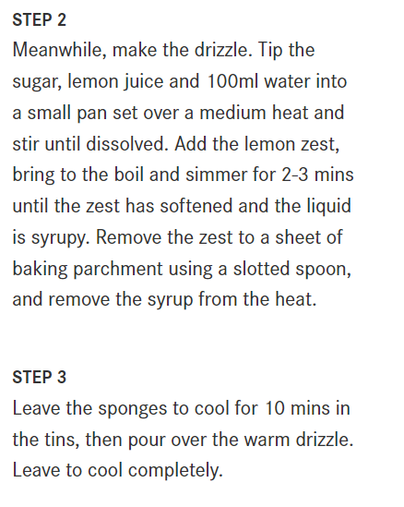
Level 2

Slide 20
Level 1
Just make the cake!

Slide 21
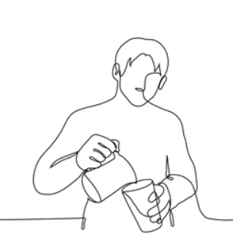
Level 3
if the milk is in the fridge
Open the fridge
Grab the milk
Open the milk
Pour the milk in a bowl
…
If the milk is not in the fridge…
…

Slide 22
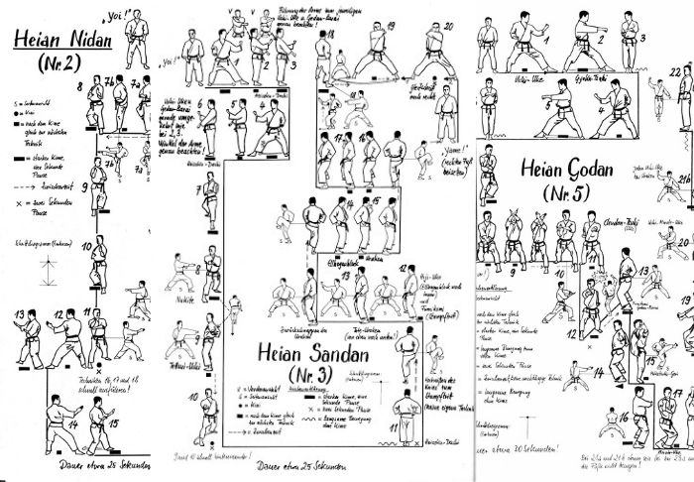
Which one is the correct one?
It depends on the purpose!
Martial arts guides are very specific on movements and posture!

Slide 23
Complex systems
A «new» series of problems
Not tractable in the usual way (from physics)

Slide 24
Social sciences
More complex
Complex
More general
Physics

Slide 25
Complex systems intro
Interconnection
Loops
Emergence
Non-linearity
Sensitivity

Slide 26
The properties of complex systems

Slide 27
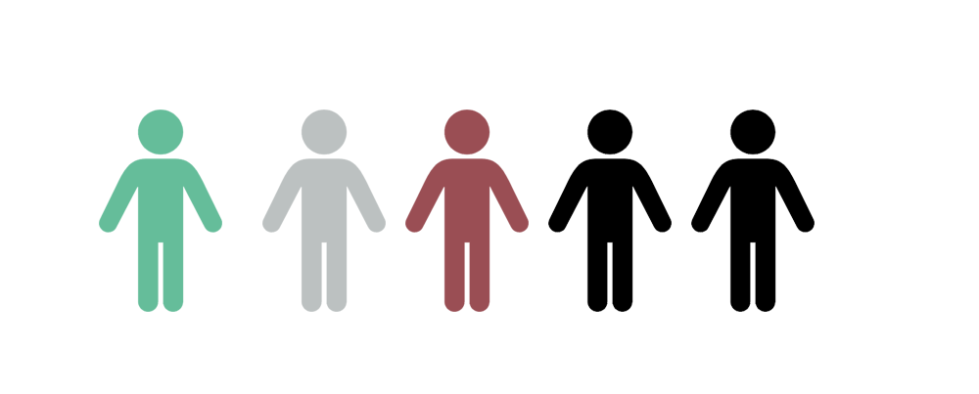
Complex systems
More than the sum of their parts?
Interaction
Interaction

Slide 28
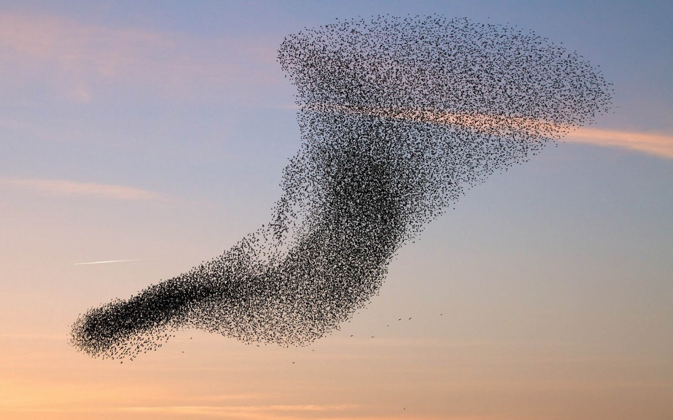
Emergence

Slide 29
Loops
Eg X says something which may be perceived offensive to Y
Y respondes in an aggressive tone to X
X makes a joke about Y
Y insults X
…

Slide 30
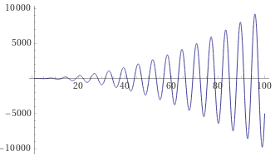
Amplification

Slide 31

Chaos theory
Some systems may be very stable also from strong fluctuations
Instability -> chaos
The butterfly effect

Slide 32
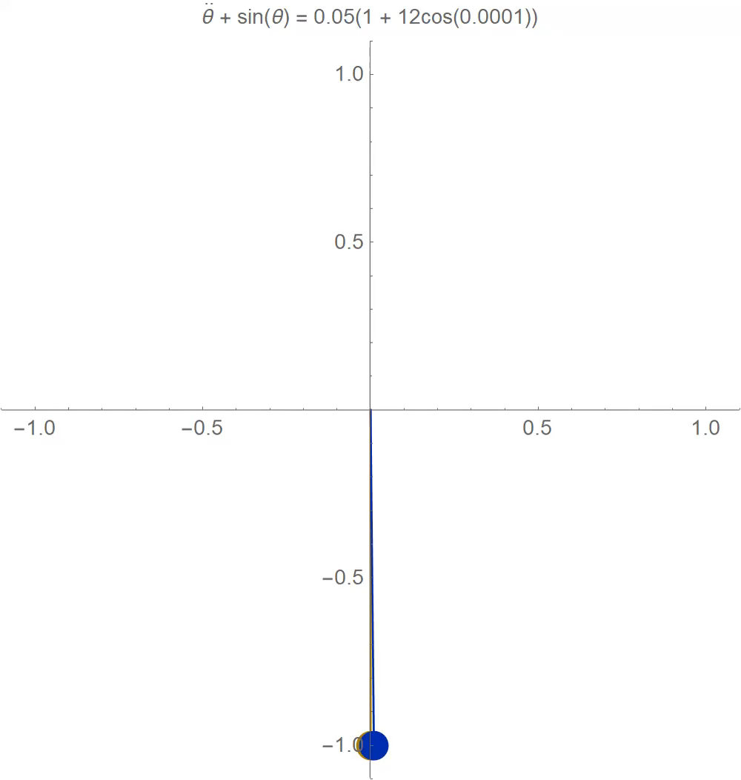
Source
(1) Arnaldo Rodriguez-Gonzalez on Twitter: "More homework for @stevenstrogatz's class: chaos in weakly forced pendulums! #math #GIF Two identical pendulums are pushed/pulled periodically. Although they start in nearly the same place, they do totally different things after a bit. What do you think causes them to separate? https://t.co/HBwBPYeVKg" / Twitter

Slide 33
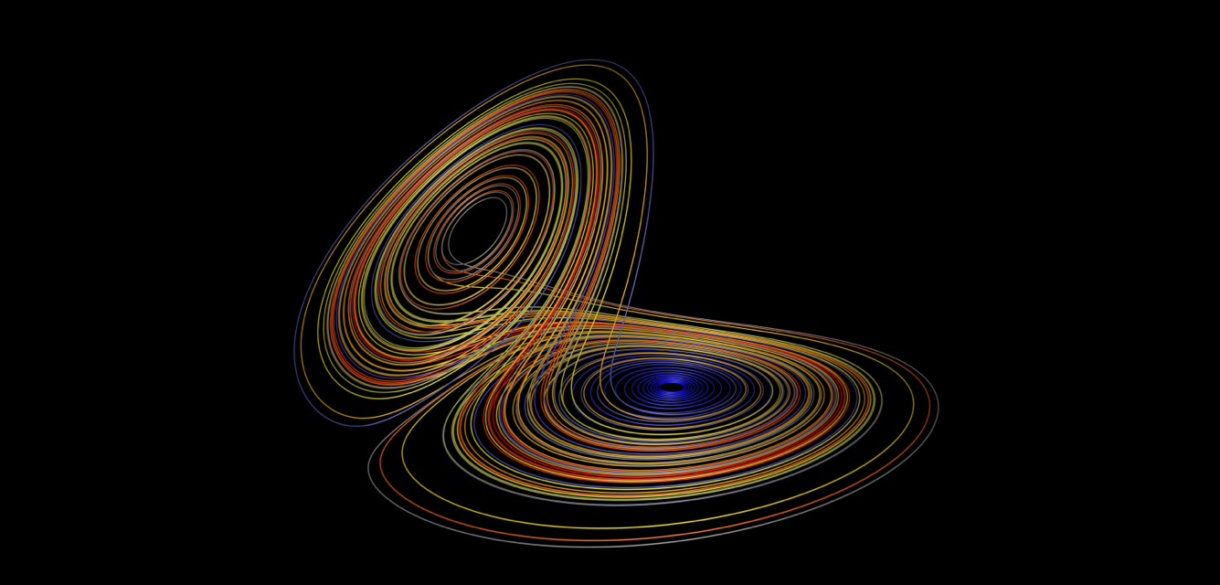
Stability to perturbations
Attractors
Stability loops

Slide 34
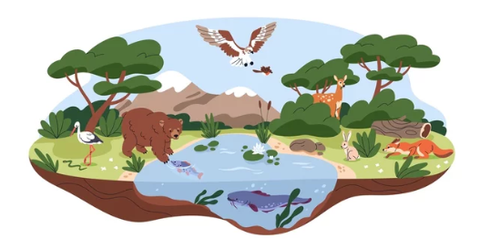
What is the best strategy?
Concept of the fittest
Other agents are the environment
So in many cases there is no best strategy

Slide 35
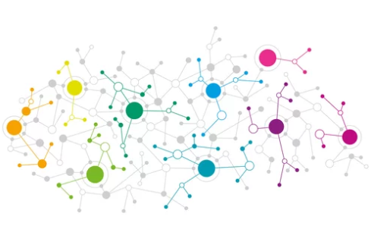

Two main approaches
Networks
Very popular in data science
More mathematically tractable
ABM
More in the social sciences

Slide 36

The dark side of complexity
Too much makes it impossible to understand
«can we use just a linear regression?»

Slide 37
ABM intro

Slide 38
Basics of ABM

Slide 39

Videogames
Did you ever play the sims?
Parameters
Interactions

Slide 40


Differences
Videogames are made for fun
Usually a playable character
Messiness is not a problem
ABM are made for science
No PG
Reproducibility
Testing hypotheses

Slide 41
ABM, Learning, automata

Slide 42
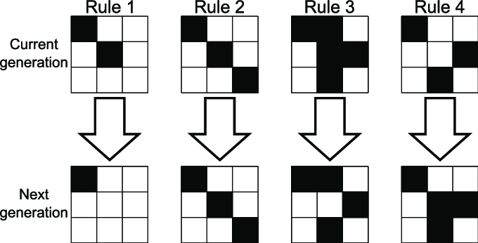
Automata
Only in a grid
Usually a few states
Simple rules

Slide 43
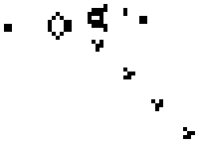
Conway’s game of life

Slide 44
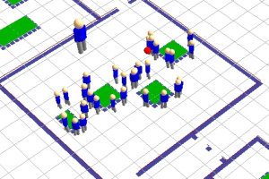
ABM
More complex than automata
Agents can follow any rule
As complex as you like
As diverse as you like
The space can be anything

Slide 45
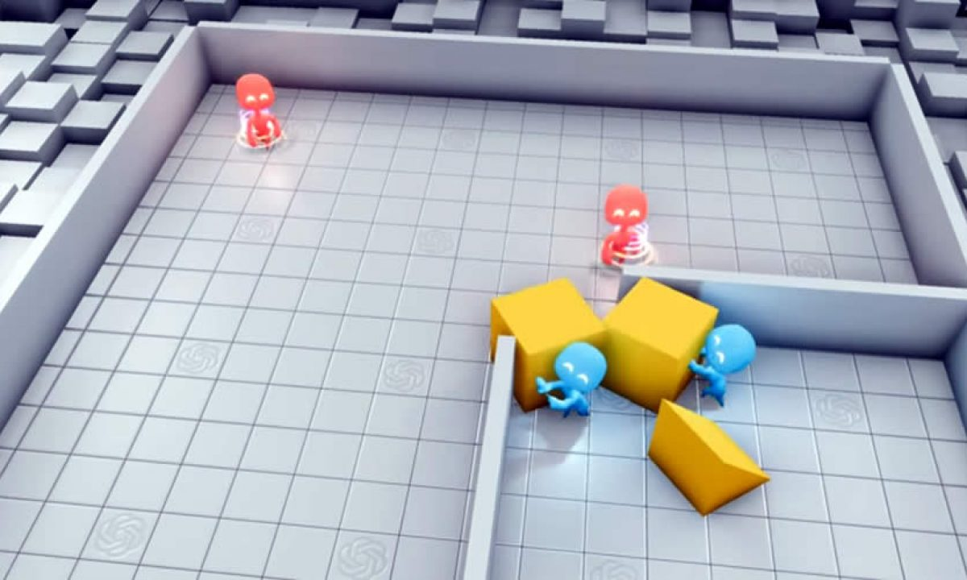
Learning

Slide 46

What is the goal in many social systems?

Slide 47
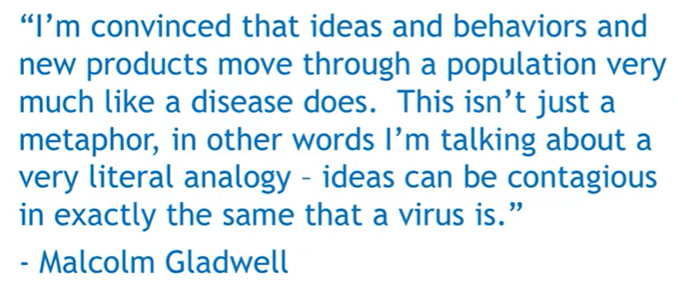
Another confusing term
Network
Contagion models
Memetics
Game theory

Slide 48
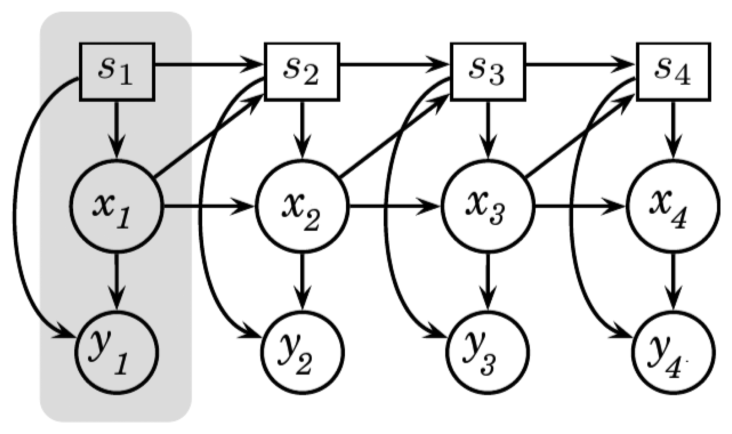
Other popular approaches
Dynamical systems
(similar to SEM but dynamic)

Slide 49
More in depth

Slide 50
Math modelling
1,2, inf
For N >> 2 but <<inf
We need simulations

Slide 51
ABM -> ABS
Math models
At the end they are simulations

Slide 52
Agents
As simple/complex as you like
Diversity
Turtles and patches
Just different classes of agents

Slide 53
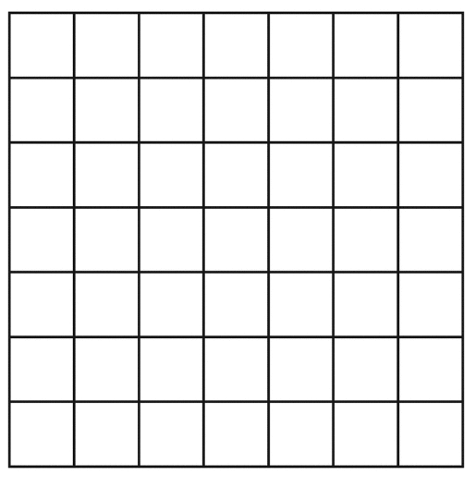


Space
Lattice
Networks
Both

Slide 54
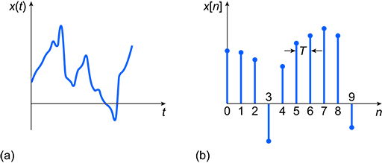
Time
Discrete
Ticks

Slide 55
Synch Vs asynch
Synch
Automata
Asynch
ABM
Eternal loops

Slide 56
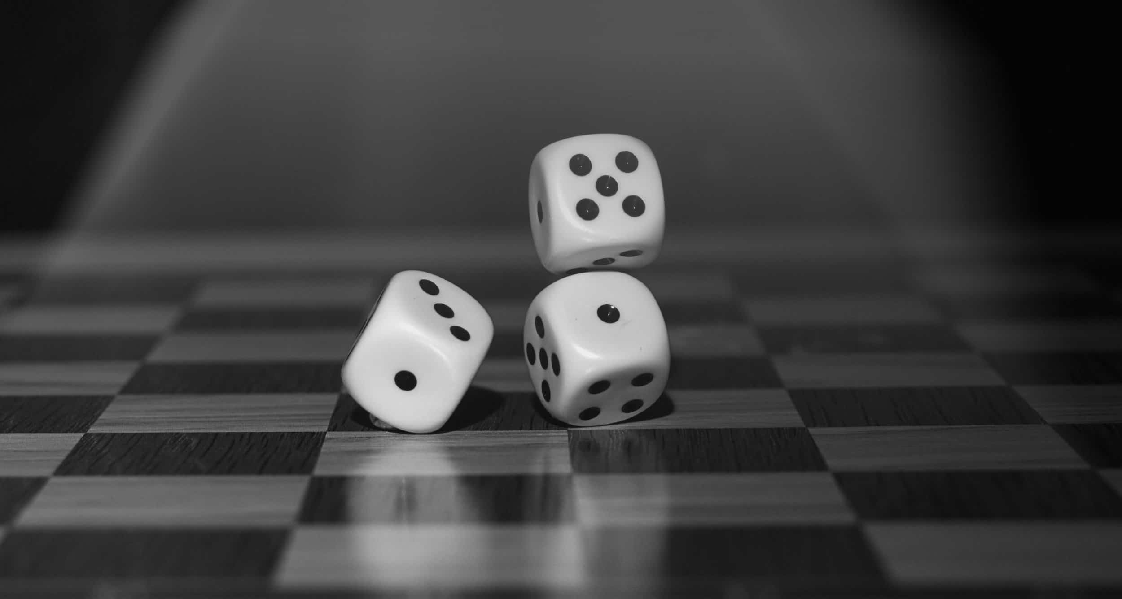
Randomness
Introduce some random changes

Slide 57
Dependent & independent variables?
In dynamic systems you don’t really have this distinction
A variable can influence its own state in the future

Slide 58
Example
Sheep-wolf
Number of parameters
stability

Slide 59
An alternative to language-based models
E.g. the Deffuant model
If people get more similar when they interact do they converge?

Slide 60
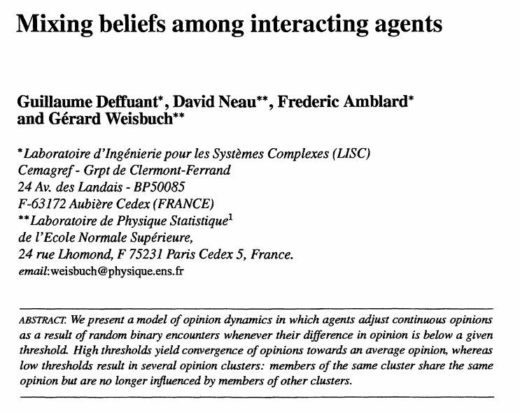
The Deffuant model
Deffuant, G., Neau, D., Amblard, F., & Weisbuch, G. (2000). Mixing beliefs among interacting agents. Advances in Complex Systems, 3(01n04), 87-98.

Slide 61

Visualization: interaction cases
Can interact
0
1
Cannot interact
(nothing happens)
0
1

Slide 62
Visualization: interaction
0
1
They will move the same amount in the direction of the middle point

Slide 63
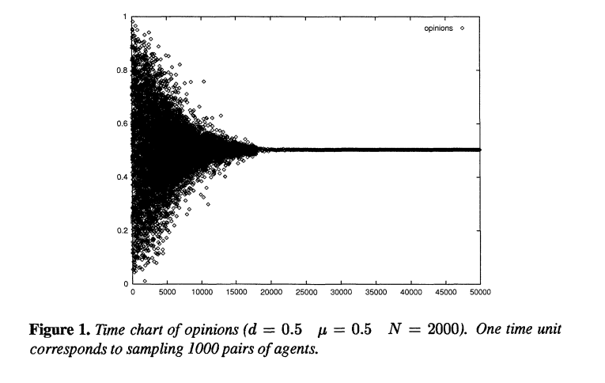
Results: single culture

Slide 64
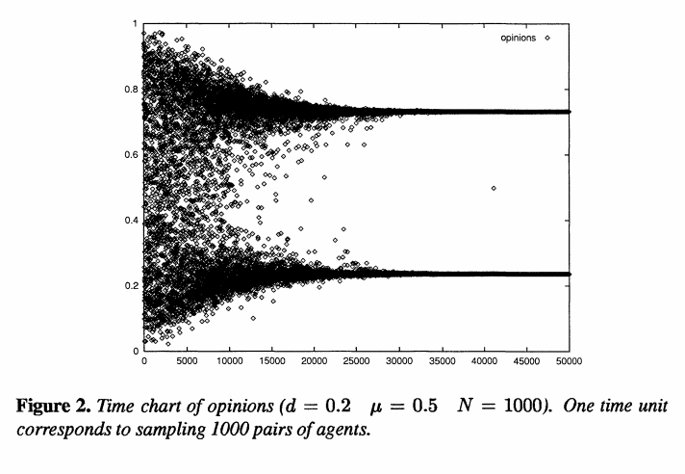
Results: Diversity of opinions

Slide 65
Another version
1
-1
1

Slide 66

Another version
1
-1
1

Slide 67
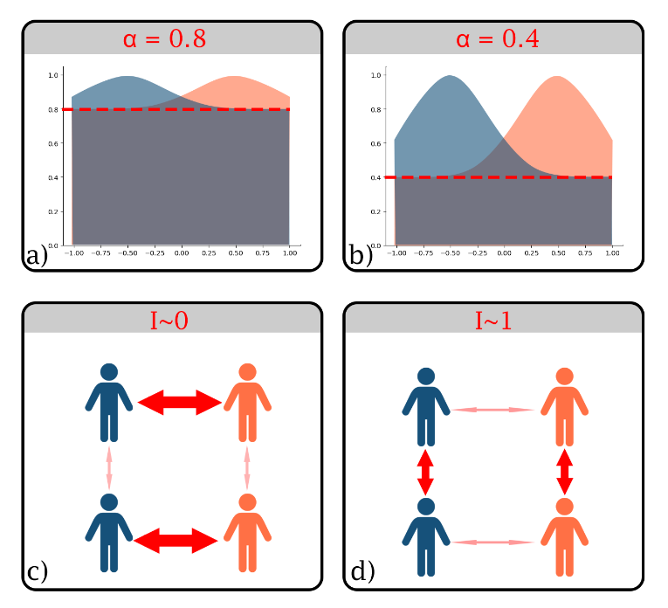

Slide 68
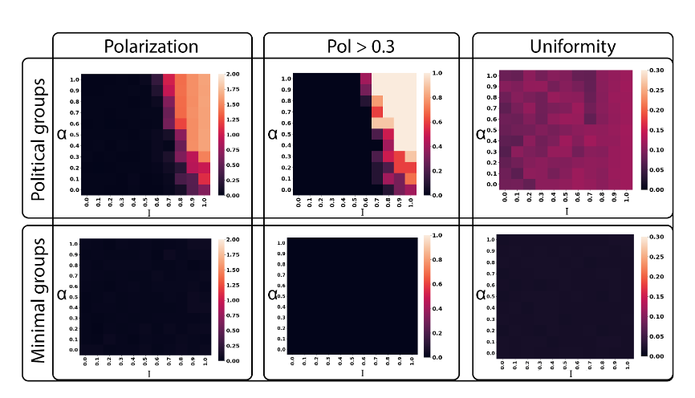
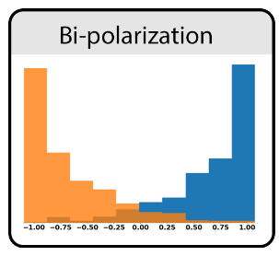
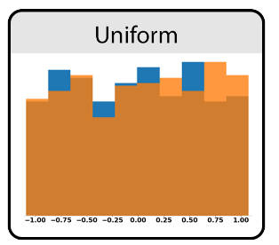
Another version

Slide 69
Respect to language-based models
Make all hypotheses explicit
They are testable even without data
(up to a certain level)

Slide 70
Technical info

Slide 71
Modeling approaces
KISS
Keep the model as simple as possible
KIDS
Models should be descriptive

Slide 72
Representative agent approach

Slide 73
ABMs are about interactions!
Example of model
If we increase trust
People will vaccinate more
It is statistics masked as ABM

Slide 74
Special: psychometrics

Slide 75
Impact of psychometrics
Psychometric measurements are ordinal
ABM suppose interval

Slide 76
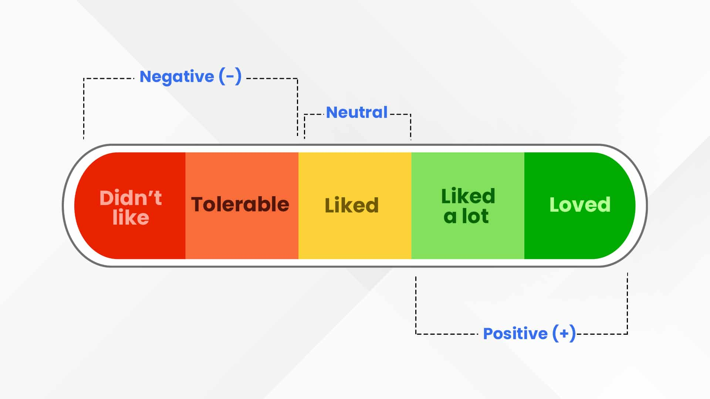
Psychometric measurements are ordinal

Slide 77
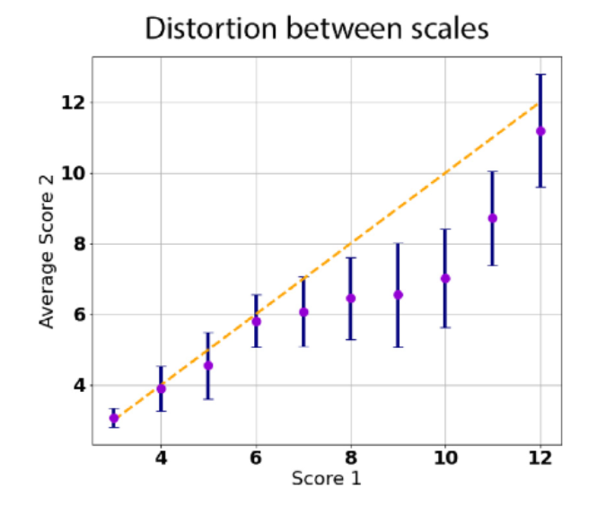
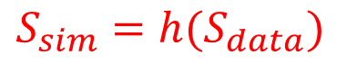
How to use ordinal scales with interval models
$$S_{sim}=h(S_{data})$$
h is unknown
But monotonic
You can test your model on different h functions
Carpentras, D., & Quayle, M. (2022). Propagation of measurement error in opinion dynamics models: The case of the Deffuant model. Physica A: Statistical Mechanics and its Applications, 606, 127993.

Slide 78
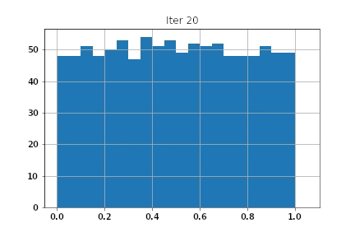
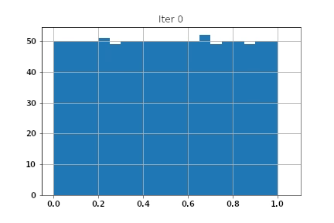
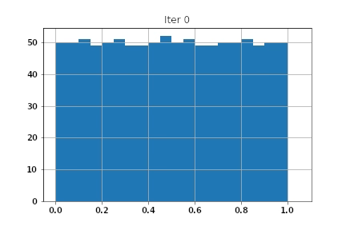
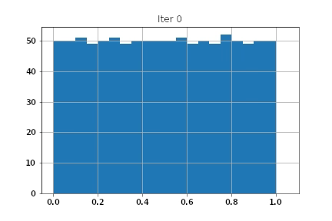
Which one is the Deffuant model?
Eps=d=1, mu=0.5, N_agents=1000, N_iterations = 1000
a)
b)
c)
d)

Slide 79
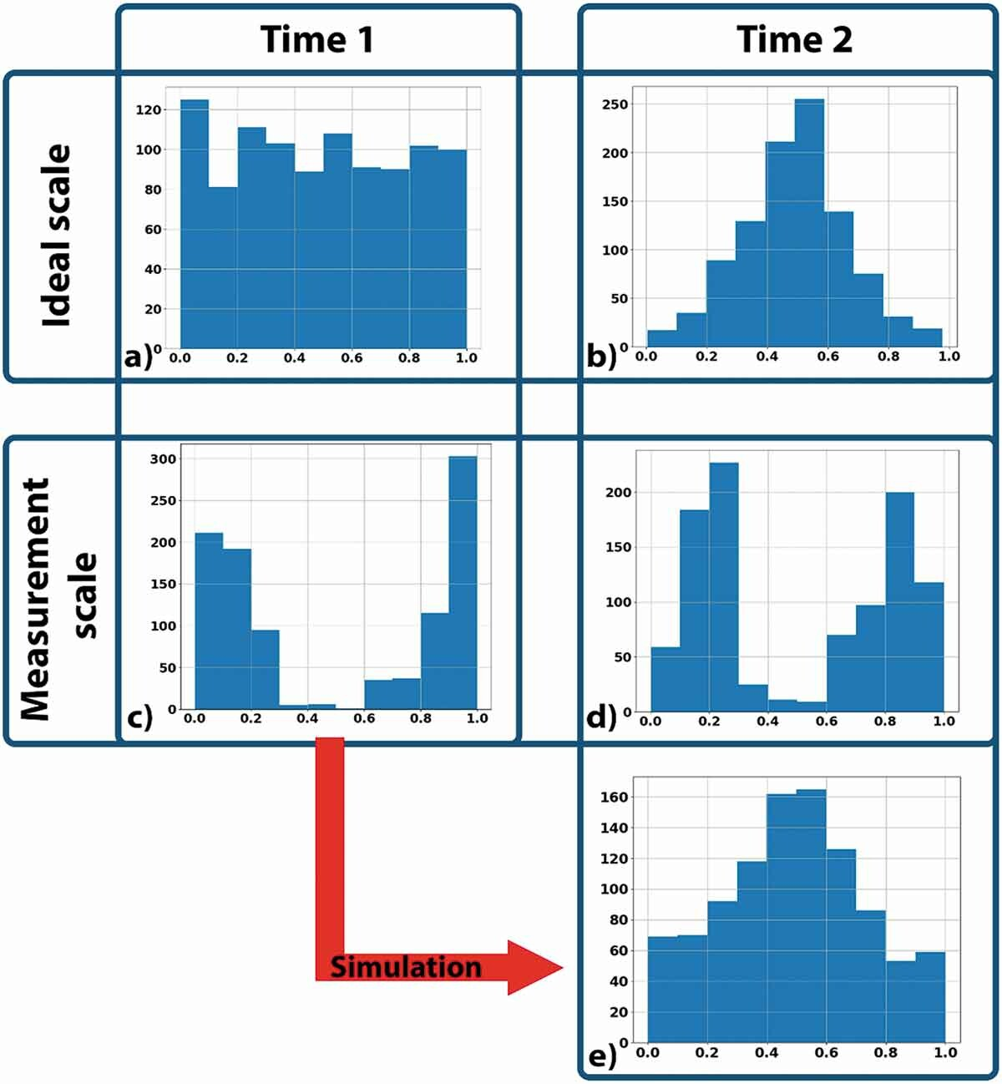
A perfect Deffuant dynamics

Slide 80
Operative
definitions
Model
/result
Meas 1
Dyn 1
Definition
Chips
Meas 2
Dyn 2
Meas 3
Dyn 3

Slide 81
Operative
definitions
Model
/result
Meas 1
Dyn 1
Definition
Chips
Meas 2
Dyn 2
Meas 3
Dyn 3

Slide 82
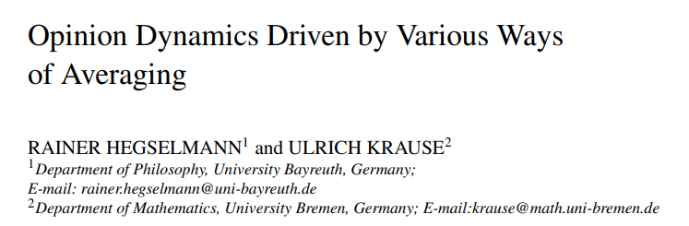
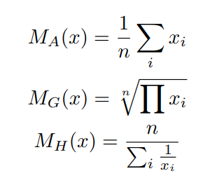
The models
3 models from Hegselmann & Krause

Slide 83
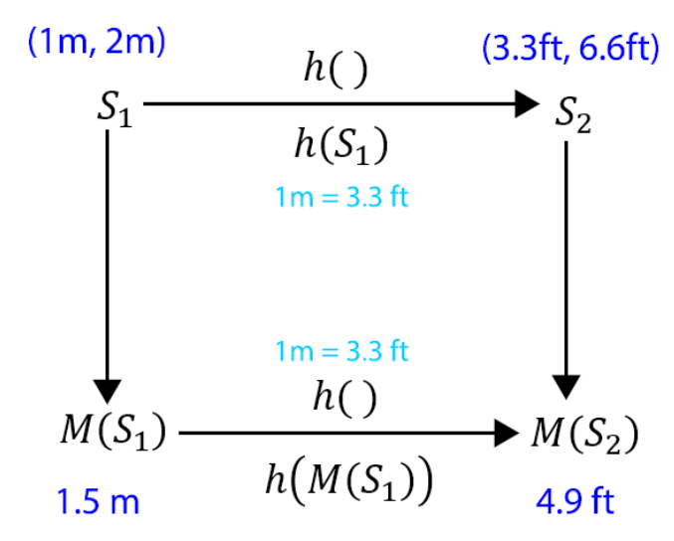
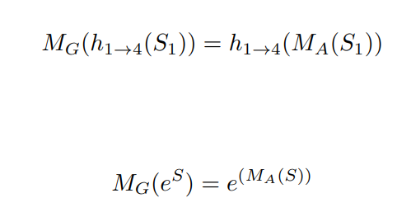
Example of equivalence

Slide 84
Models equivalence
Meas 1
Model 1
Sim ground truth
Meas 2
Model 2
Result
Meas 3
Model 3

Slide 85
When they look different
Model 1
Result 1
Sim ground truth
Meas 1
Model 2
Result 2
Model 3
Result 3

Slide 86
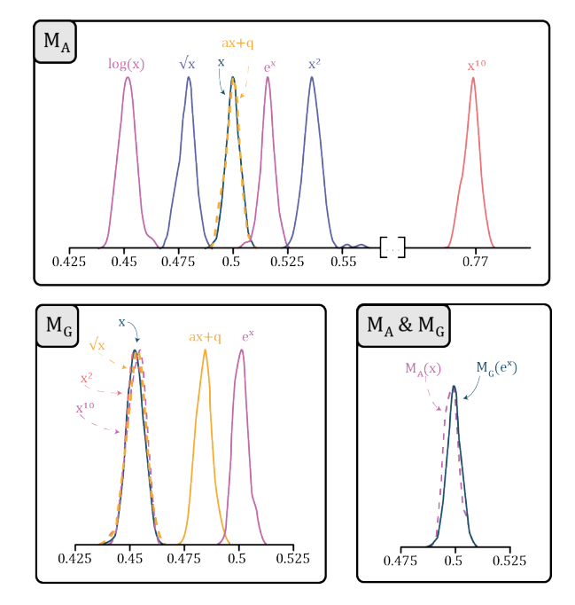
Models equivalence
Carpentras, D., Dinkelberg, A., & Quayle, M. (2020). A new degree of freedom for opinion dynamics models: the arbitrariness of scales. arXiv preprint arXiv:2010.04788.

Slide 87
Naive use of models
(real world)
data
Model
Predictions

Slide 88
More in depth
Measured
data
Scale 1
Model
Population
Scale 2
Prediction
Scale 3

Slide 89
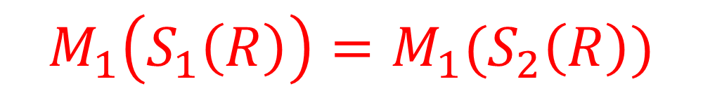
In formula
$$M_{1}\left(S_{1}\left(R\right)\right)=M_{1}(S_{2}\left(R\right))$$
R = Reality
S = Measurement function (casting reality into a set of numbers)
M = model
It will hold only if S1=S2

Slide 90

Predictions
Trust in science
Deffuant model
Scale 1
Model
Trust
Scale 2
Distrust
Carpentras, D., & Quayle, M. (2022). Propagation of measurement error in opinion dynamics models: The case of the Deffuant model. Physica A: Statistical Mechanics and its Applications, 606, 127993.

Slide 91
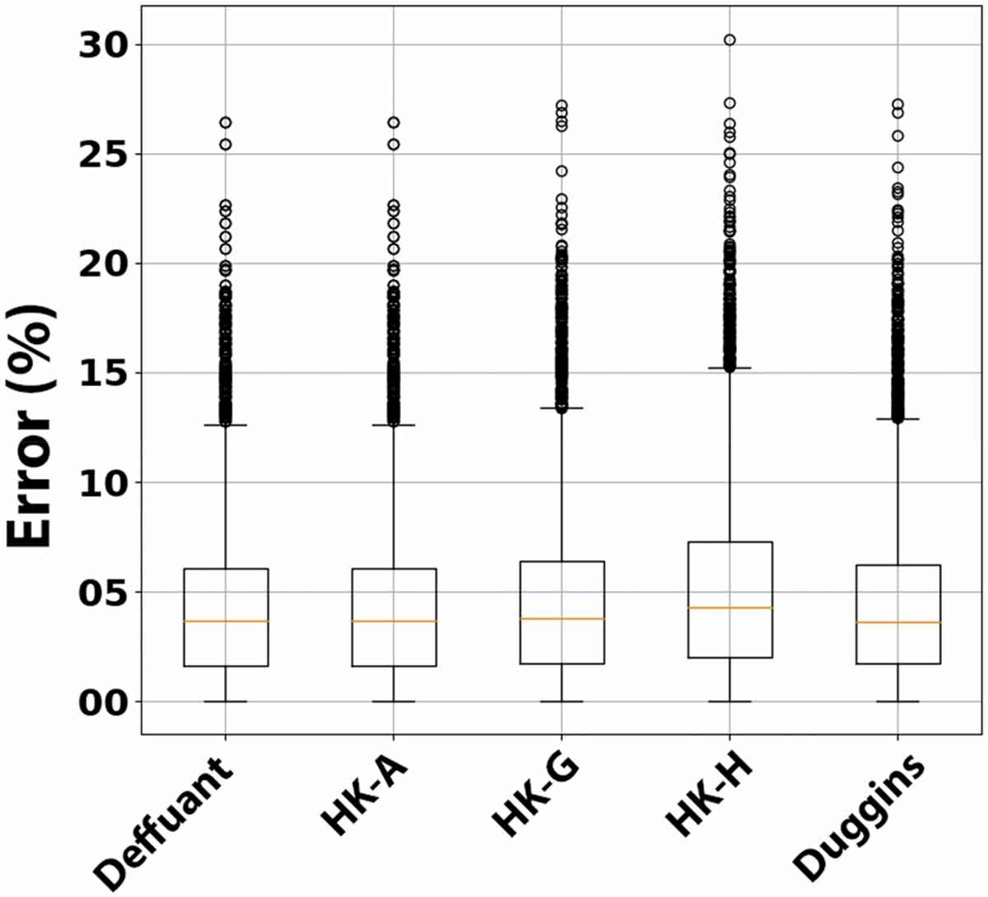
Multiple models
All data are from the same dataset
(Wellcome Global Monitor 2018)

Slide 92
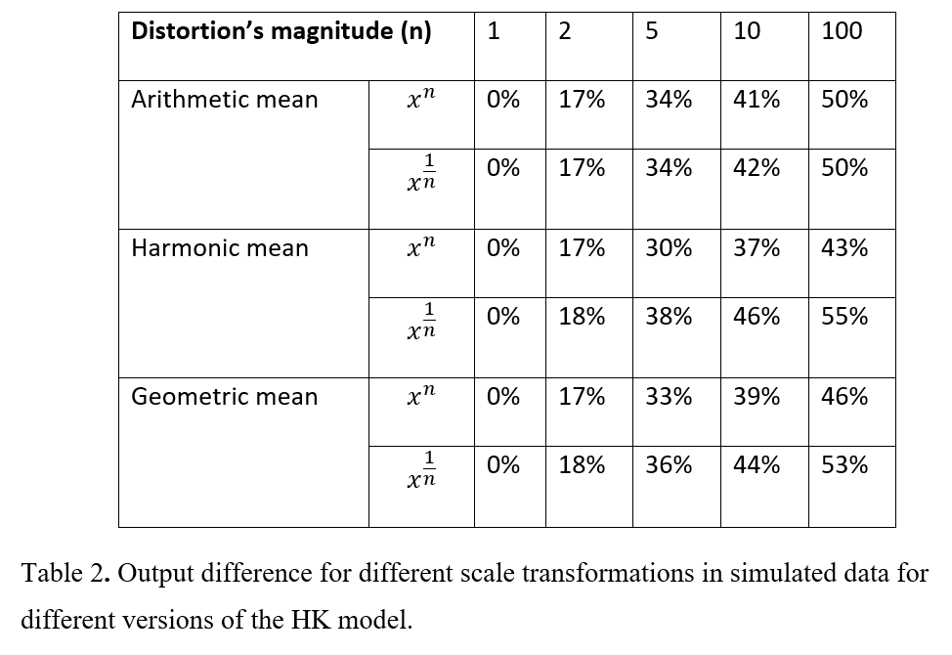
Similar study for HK models
Carpentras, D., & Quayle, M. (2022 In press). The psychometric house-of-mirrors: the effect of measurement distortions on agent-based models’ predictions. International Journal of Social Research Methodology IJSRM

Slide 93
Special: Model analysis

Slide 94
Calibration and validation

Slide 95


Why do you make model?
For fun?
Play / discover [abstract model]
For explaining how the world works?
Emergent phenomena [abstract model + stylized facts]
For making predictions? For optimization? Or for finding solutions?
[Good relationship between model and reality]

Slide 96
Model’s properties
Parameters & variables
Initialization values
Static parameters
Variables (time)
Rules
How agents interact
How the environment respond
Outcomes
Final state of the system
Measurables

Slide 97
Three main types of analysis
Sensitivity analysis
Calibration
Validation

Slide 98
General scheme
p1
Model
p2
output
p3

Slide 99
Sensitivity analysis
p1
Model
p2
output
p3

Slide 100
Calibration
p1
Model
Wanted result/ data
p2
p3

Slide 101
Validation
p1
p2
p3
Model
output
Real world

Slide 102
General problems

Slide 103

Main problem
ABM usually have a lot of parameters
Number of agents
Network/lattice - type of movement
Initialization parameters
…

Slide 104
Non-linearity
ABMs are strongly non linear
You cannot separate the variables like in linear systems
Small changes can have a strong effect

Slide 105


«Ghost in the model»

Slide 106


Resulting dynamics
Interaction functions
Edmonds, B. (2005). Assessing the safety of (numerical) representation in social simulation. Agent-based computational modelling, 195-214.

Slide 107

Why not jumping to measures?
e.g.
Goldberg, A., & Stein, S. K. (2018). Beyond social contagion: Associative diffusion and the emergence of cultural variation. American Sociological Review, 83(5), 897-932.

Slide 108

Example: 13 similar datasets…

Slide 109

Datasaurus’ dozen
Source: https://cran.r-project.org/web/packages/datasauRus/vignettes/Datasaurus.html

Slide 110
Why exploring/playing with the model?
For fun!
To have a high-order understanding of how it works
Exploration of
Expected results
Unexpected results
Artifacts/bugs
Sensitivity analysis can take a very long time
You may want to start debugging before

Slide 111


Playing with ABMs (for understanding)
Bommel, P., Becu, N., Le Page, C., Bousquet, F. (2016). Cormas: An Agent-Based Simulation Platform for Coupling Human Decisions with Computerized Dynamics. In: Kaneda, T., Kanegae, H., Toyoda, Y., Rizzi, P. (eds) Simulation and Gaming in the Network Society. Translational Systems Sciences, vol 9. Springer, Singapore. https://doi.org/10.1007/978-981-10-0575-6_27
Klügl, F., & Bazzan, A. L. C. (2012). Agent-Based Modeling and Simulation. AI Magazine, 33(3), 29. https://doi.org/10.1609/aimag.v33i3.2425

Slide 112
More formally as «verification»
Verification is a procedure to ensure that the model is built according to specifications and to eliminate errors in the structure, algorithm and computer implementation of the model
Wilniewczyc, M. P. (1999). Electro-mechanical analysis of thin-film substrate fuses using finite element methodology. Sheffield Hallam University (United Kingdom).

Slide 113
What is an artifact?
Model
Real world
relationship

Slide 114
What is an artifact?
Model properties
Model
Real world

Slide 115
Example
[Empirical] Your model predicts that the world population would double from 2022 to 2023
Very hard to believe
Artifact
[Abstract] Your model predicts that a certain population will double in time ∆t
Artifact?

Slide 116

Galàn, José Manuel, Izquierdo, Luis R., Izquierdo, Segismundo S., Santos, José Ignacio, del Olmo, Ricardo, Lopez-Paredes, Adolfo and Edmonds, Bruce (2009). 'Errors and Artefacts in Agent-Based Modelling'. Journal of Artificial Societies and Social Simulation 12(1)1

Slide 117
Qualitative
Mathematical
Pseudo-code
Code
Galàn, José Manuel, Izquierdo, Luis R., Izquierdo, Segismundo S., Santos, José Ignacio, del Olmo, Ricardo, Lopez-Paredes, Adolfo and Edmonds, Bruce (2009). 'Errors and Artefacts in Agent-Based Modelling'. Journal of Artificial Societies and Social Simulation 12(1)1

Slide 118

Example: the Ising model
Qualitative
People are influenced by those who are close by
Formal
Pseudo-code
Select a couple of agents to interact
If their sign is different…
Code
for i in range(0,N):
…
Synchronous or asynchronous?
Loops or masks?

Slide 119
Example: the Ising model
Qualitative
People are influenced by those who are close by
Formal
Pseudo-code
Select a couple of agents to interact
If their sign is different…
Code
for i in range(0,N):
…
Synchronous or asynchronous?
Loops or masks?

Slide 120
Types of artifacts
Model artifacts
The model is producing unexpected/unwanted results
Measurement artifacts
The observables are ill-defined
Notes:
32

Slide 121


Measurement artifacts
Measurement of flow
Measure 1:
Number of cars passing in $x_{0}$
Measure 2:
Number of cars passing in the interval $I_{0}$: ${(x}_{0}−Δx,x_{0}+Δx)$
$$x_{0}$$
$$I_{0}$$
Notes:
32

Slide 122





Measurement artifacts
Measurement of flow
Measure 1:
Number of cars passing in $x_{0}$
Measure 2:
Number of cars passing in the interval $I_{0}$: ${(x}_{0}−Δx,x_{0}+Δx)$
$$vΔt$$
$$2vΔt$$
$$3vΔt$$
car
$$x_{0}$$
$$I_{0}$$
Notes:
32

Slide 123
General guidelines
How to identify artifacts?
Get as close as possible to the real world
Try to specify the different steps of the modelling process
Use multiple measurements

Slide 124
Validation

Slide 125
What is validation?

Slide 126
What is validation?
Making sure that your model is a good representation of a target system
What do we mean by model?
The code?
The informal model?
What do we mean by target system?
Qualitative model?
Reality?
Datasets?
Stylized facts?

Slide 127

Problems with the term
Chattoe-Brown, E. (2022) Today We Have Naming Of Parts: A Possible Way Out Of Some Terminological Problems With ABM. Review of Artificial Societies and Social Simulation, 11th January 2022. https://rofasss.org/2022/01/11/naming-of-parts/

Slide 128

Exmple: how the term «validation» is used
Altiok, T., & Melamed, B. (2010). Simulation modeling and analysis with Arena. Elsevier.

Slide 129

Face validation
Example: face validation

Slide 130

Validation of the micro dynamics rule
Moussaïd, M., Kämmer, J. E., Analytis, P. P., & Neth, H. (2013). Social influence and the collective dynamics of opinion formation. PloS one, 8(11), e78433.

Slide 131

Example: checking result on multiple models
Show that the result does not depends on the model or on some specific parameters
Carpentras, D., Lüders, A. & Quayle, M. Mapping the global opinion space to explain anti-vaccine attraction. Sci Rep 12, 6188 (2022). https://doi.org/10.1038/s41598-022-10069-3

Slide 132
«classic» validation
p1
p2
p3
Model
output
Real world data

Slide 133
Why do we need validation?
Isn’t calibration enough?
We already have a measurement of how well the model fit the data…

Slide 134
Calibration
Tells you the best parameters… for a given dataset
Is this enough to say that the model is a good representation of reality?
How the model will work on other datasets?

Slide 135

Example: data fitting
Generated as y= x^2 + noise

Slide 136

Fitting functions
Polynomials
Degree 2
Degree 8
Degree 15
Which one is going to be the best?

Slide 137

Degree 2
Err=13

Slide 138

Degree 8
Err=11

Slide 139

Degree 15
Err=10

Slide 140
Whic one is the best?
In terms of fit/error the more degrees of freedom the better
Is this true also for predictions?
Let’s repeat with another dataset having the same properties

Slide 141

Degree 2
Err=14

Slide 142

Degree 8
Err=53

Slide 143

Degree 15
Err= 75’980

Slide 144
Difference
Error in calibration
More parameters usually produce a better result
Error in validation
More parameters can severely damage the model

Slide 145
Validation + calibration
To validate you need a calibrated model (on a dataset)
Problem: if you test your model on the same dataset you will obtain the same result
Solutions:
Use a new dataset
Split the dataset in half
Training dataset
Test dataset

Slide 146

Problem of changing units
Some pheonomena are not linear
E.g. noise
Some units are non-linear
Psychological measurements

Slide 147
Types of claims

Slide 148
Bad claims
I calibrated my model
So it is valid
And I can make recommendations about policies
It has a better fit than another model
So my model is better

Slide 149
What you can say
Tests
Claims

Slide 150
Sensitivity analysis
Claims about the abstract model
With face validity/emergence
Which rules/conditions are sufficient for generating a result
Disproof of some claims e.g. affirming the consequent

Slide 151
Emergence
Flocking
3 rules are enough to produce similar results

Slide 152
Claim to disprof
A generates B
I observe B, therefore A is true
You can generate B from C showing that this is not the case
A
B
C

Slide 153
Examples: Deffuant & Schelling’s models
If you have only attractive forces the World would converge to monoculture
False: see Deffuant model
Schelling’s model of segregation
You can have strong segregation from wanting a small group of similar people in your neighbour
Tipping point

Slide 154
Calibrated model
The model fits well the data
Very weak validation

Slide 155
Validated model
Link (empirical) micro-behavior to (empirical) macro behavior
Make predictions
Find solutions

Slide 156
In the social sciences
Language-based
model
Consequences

Slide 157
In the social sciences
Language-based
model
Consequences
ABM

Slide 158
In the social sciences
ABM
Language-based
model
Consequences
ABM
ABM

Slide 159
Why multiple ABMs?
You can study how robust is the connection between the language-based model and the results

Slide 160
Take home messages
There are three main analysis on models
Sensitivity analysis
How the parameters affect outcomes
Calibration
Which set of parameters produces a specific outcome
Validation
The model is a good representation of reality

Slide 161
Application: the study of vaccine-related opinons

Slide 162
Analysis of vaccine-related attitudes
Expected result
Anti-vaxxers are extremists so they should be far apart

Slide 163

Analysis of vaccine-related attitudes
Carpentras, D., Lüders, A. & Quayle, M. Mapping the global opinion space to explain anti-vaccine attraction. Sci Rep 12, 6188 (2022). https://doi.org/10.1038/s41598-022-10069-3

Slide 164
Analysis of vaccine-related attitudes
Carpentras, D., Lüders, A. & Quayle, M. Mapping the global opinion space to explain anti-vaccine attraction. Sci Rep 12, 6188 (2022). https://doi.org/10.1038/s41598-022-10069-3

Slide 165
Analysis of vaccine-related attitudes
Is this an artifact?
Carpentras, D., Lüders, A. & Quayle, M. Mapping the global opinion space to explain anti-vaccine attraction. Sci Rep 12, 6188 (2022). https://doi.org/10.1038/s41598-022-10069-3

Slide 166

Verification

Slide 167


The paradox of vaccination
Pro-vaxxers have multiple advantages
Majority
Traditional media
Experts (both in communication and in virology)
Communication campaigns (with massive budgets)
Anti-vaxxers as derogatory
…
Still, anti-vaxxers are better at connecting with the neutral and bringing them on their side

Slide 168

Social influence interpretation

Slide 169
Is it true?

Slide 170

Simulations

Slide 171
Simulations

Slide 172
Simulations

Slide 173
Is it true?
Theory says so…

Slide 174

Distance vs final position
Data - vacc coverage
r=-0.31***
Data - trust
r = -0.32*

Slide 175
Policy making implication
Boosting trust in vaccines (without looking at the attitude space)

Slide 176
Policy making implication
Boosting trust in vaccines (without looking at the attitude space)

Slide 177
Blind optimization of trust
Immediate boost of trust
(hidden) decrease of social influence
In time, neutrals are more influenced by anti-vaxxers
(unexpected) increase of anti-vaxxers

